Slide 1
Lecture 06
Semantic Analysis

Slide 2
Outline
Semantic Analysis
Overview of Semantic Analysis
Attributes and Attribute Grammars
Dependency Graphs and Algorithms for Attribute Computation
Symbol Table and Scope Checking
Type Checking for Semantic Analysis of a Program

Slide 3
V. Semantic Analysis of a Program
Declarations
Typically, the information in declarations is inserted into a symbol table for later lookup during the translation of other parts of the program
Assume that insert(id.name,dtype) is a procedure that insets an identifier into the symbol table and associates a type to it
Attribute grammar is as follow:

Slide 4
Attribute grammar is as follow:
Grammar rule | Semantic Rules
decl->type varlist | varlist.dtype=type.dtype
type->int | type.dtype=integer
type->float | type.dtype=real
varlist1->id,varlist2 | insert(id.name,varlist1.dtype) varlist2.dtype =varlist1.dtype
var-list->id | insert(id.name,varlist.dtype)

Slide 5
2. Statements
Semantic analysis of statements is mainly type checking (the use of type information to ensure that each part of a program makes sense under the type rules of the language)
A simple grammar to illustrate semantic analysis
stmt->id:=exp
stmt->if exp then stmt
exp-> exp1+exp2
exp->exp1 or exp2
exp-> id

Slide 6
Attributes and Procedures used in attribute grammar
We assume the availability of a symbol table that contains variable names and associated data types
Attribute:
name of an identifier
dtype of grammar symbol
Procedures:
lookup(id.name), which returns the associated type of a name if it has already in the symbol table, otherwise returns nil
error, which reports semantic errors

Slide 7
Attribute grammar for semantic analysis (Type Checking) of simple grammar
Grammar rule | Semantic Rules
exp→exp1+exp2 | if exp1.type≠integer or exp2.type≠integer then error else exp.type=integer
exp→exp1 or exp2 | if exp1.type ≠boolean or exp2.type ≠boolean then error else exp.type=boolean
exp→id | t=lookup(id.name) if t ≠nil then exp.type=t else error
id→num | id.type = integer
stmt→id:=exp | t=lookup(id.name) if t=nil then error else if t ≠ exp.type then error
stmt→if exp then stmt | if exp.type ≠ boolean then error

Slide 8
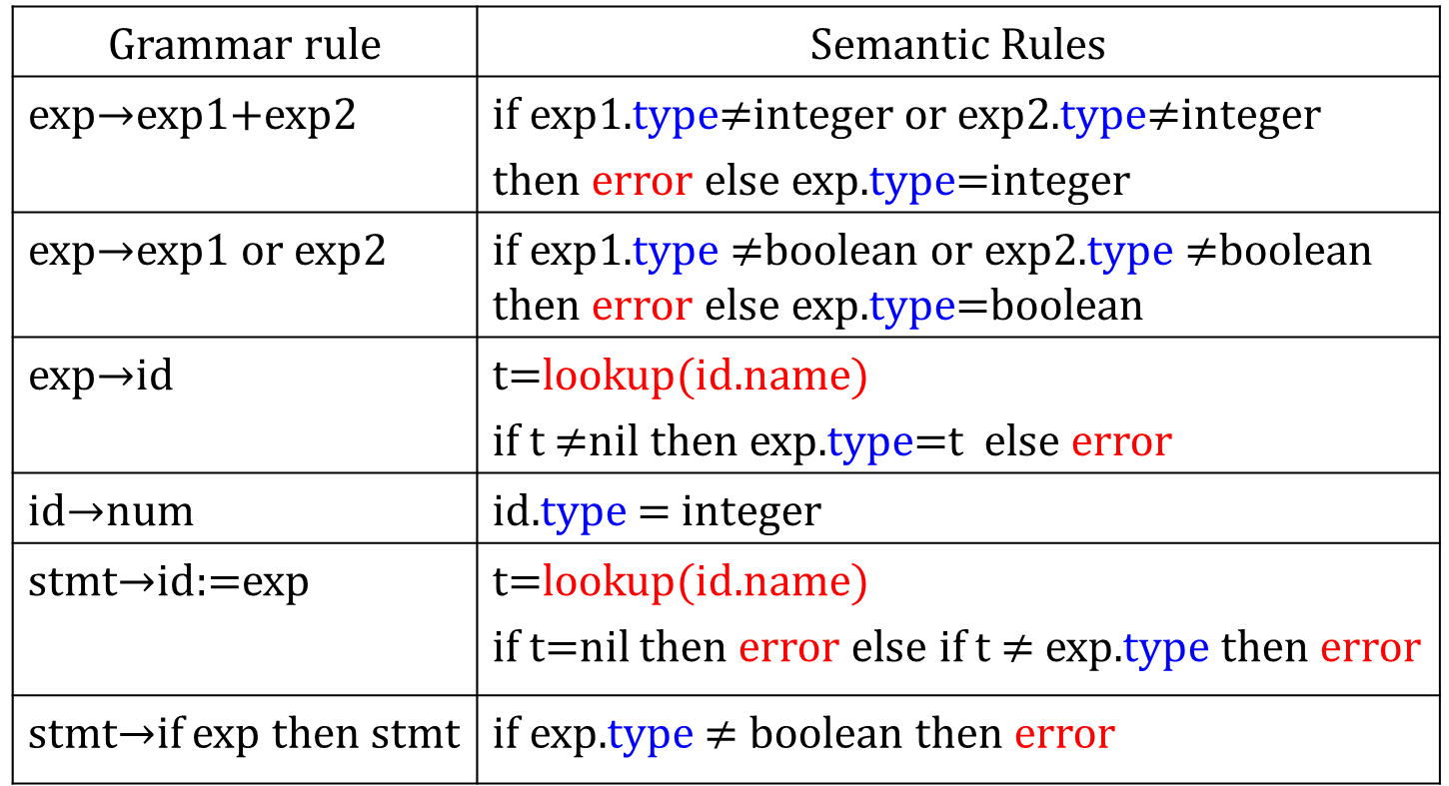
Type Checking(An example)
if( 1 + 4 ) then /* … */
stmt
if
exp
then
…
(type=integer)
error
id
id
+
(type=integer)
(type=integer)
1
4

